Slide 1

Module 6
Logistic Regression
Notes:
Guidelines
Use section headers to chunk content in your presentation.
Use the same style of section header throughout your presentation.
Keep your title to no more than 2 lines.

Slide 2
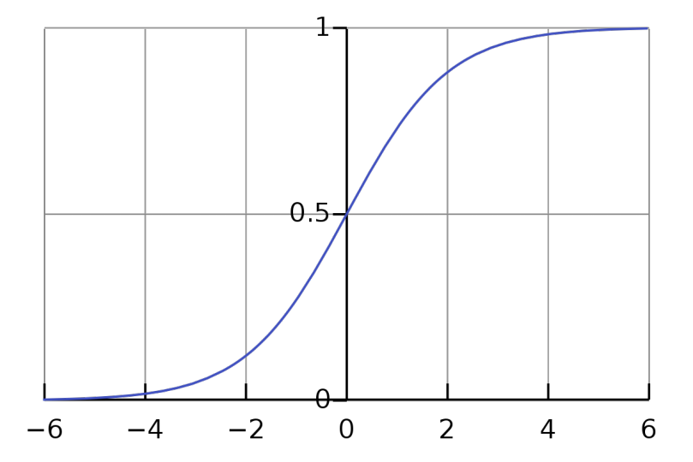
Logistic Regression (Predictive)
Notes:
Guidelines
Use a title slide at the beginning of your presentation. There are 9 variations of title slides to choose from.
If you will have a series of slideshows, we recommend using the same style of title slide for each presentation.
Keep your title to no more than 2 lines.
Do not change the font style or font size of the title or subtitle.

Slide 3
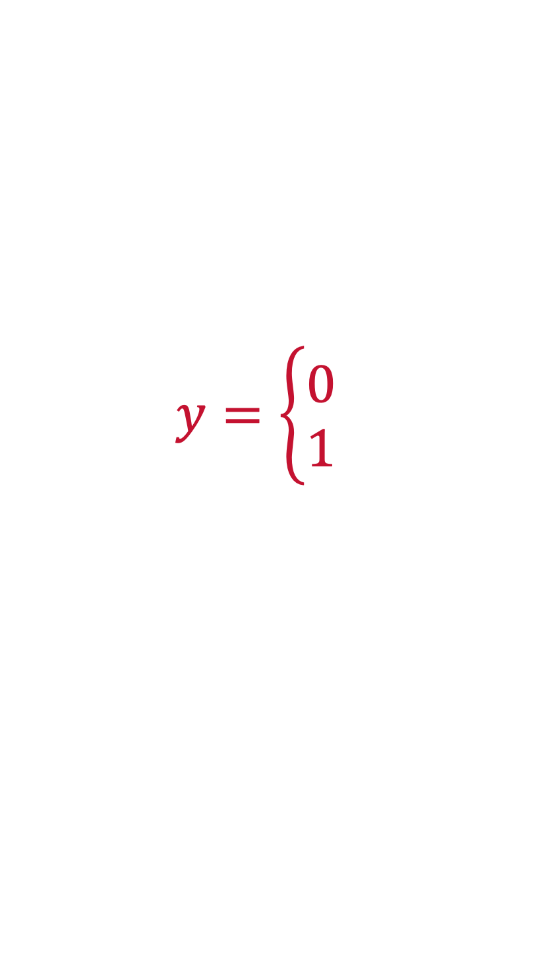
Logistic Regression as Predictive Model
The main goal is to obtain accurate predictions.
Goodness of fit metrics are second to performance metrics
Relationships and odds are of lesser importance
$$y=\left\{\begin{aligned}0 \\ 1\end{aligned}\right.$$

Slide 4
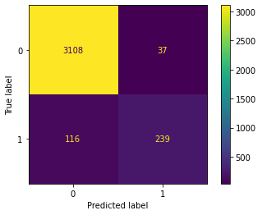
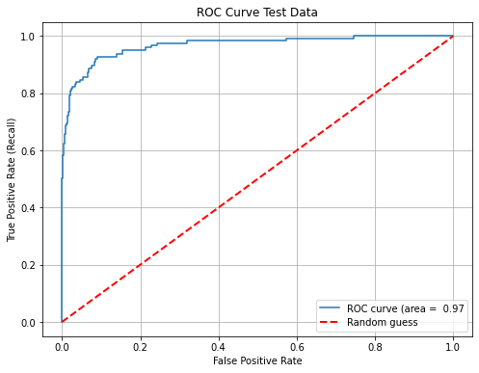
Logistic Regression as Predictive Model
We optimize test error performance
Grid-search, CV and hyperparameter tuning are essential
Train set performance is used to compare to Test (Overfitting)

Slide 5
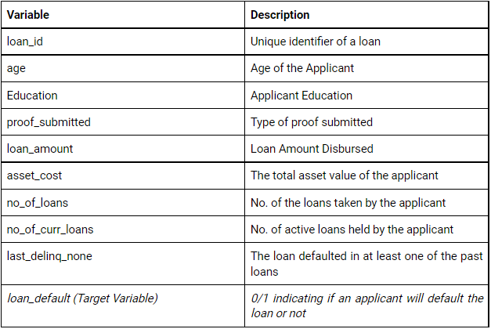
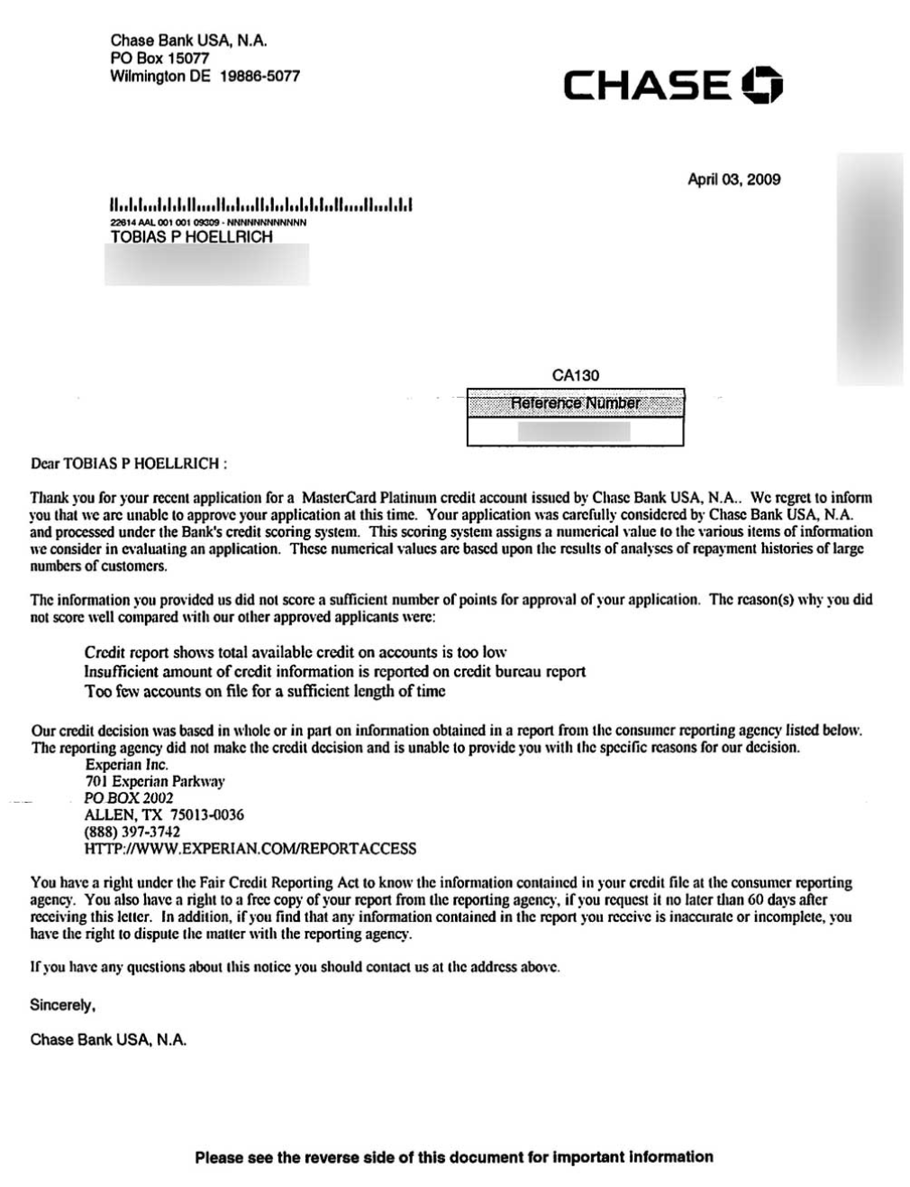
What type of model is more useful?
Both. Often, a hybrid approach is needed.

Slide 6
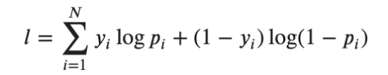
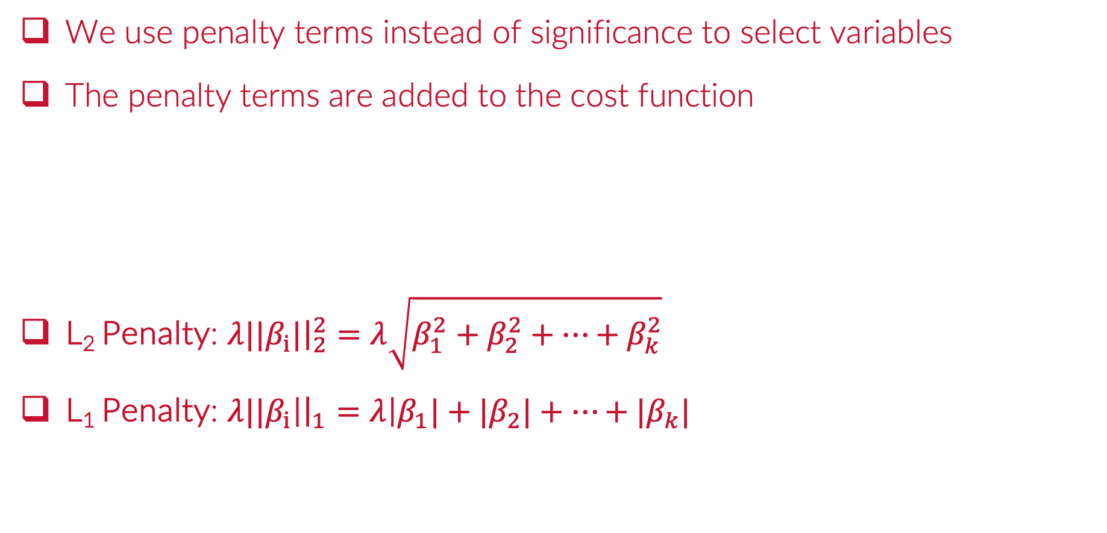
How are variables selected?
We use penalty terms instead of significance to select variables
The penalty terms are added to the cost function
L₂ Penalty: ${λ||β}_{i}|{\left.​\right|}_{2}^{2}=λ\sqrt{β_{1}^{2}+β_{2}^{2}+…+β_{k}^{2}}$
L₁ Penalty: ${λ||β}_{i}\left|{\left.​\right|}_{1}=λ\right|β_{1}|+{|β}_{2}|+…+|β_{k}|$

Slide 7
Python
Notes:
Guidelines
Use a title slide at the beginning of your presentation. There are 9 variations of title slides to choose from.
If you will have a series of slideshows, we recommend using the same style of title slide for each presentation.
Keep your title to no more than 2 lines.
Do not change the font style or font size of the title or subtitle.

